Slide 1



Road Lane Line Detection (RLLD)
Road lane line detection in fog using Computer Vision

Slide 2
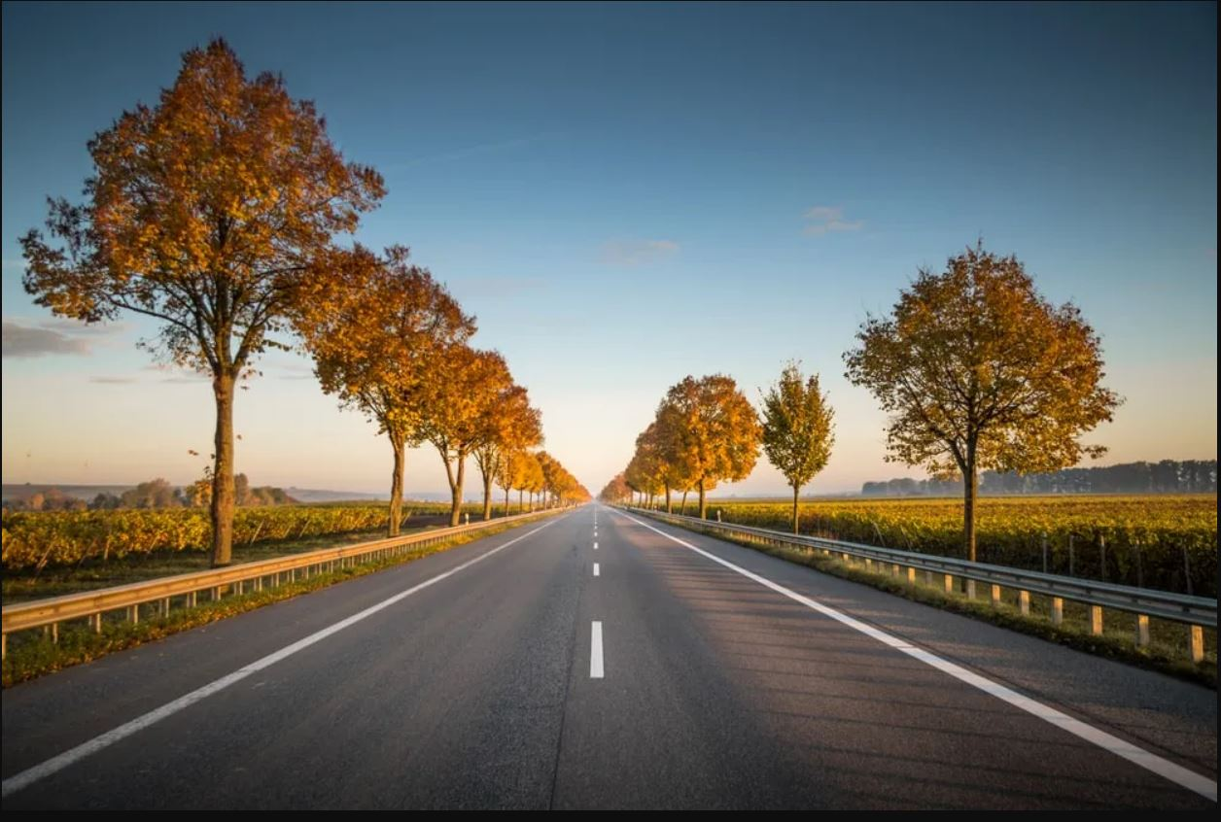
Road Lane Line Detection (RLLD)
TABLE OF CONTENTS

Slide 3
01
02
03
04
05
Road Lane Line Detection
Introduction
Aims
Scope of Computer Vision
Similar Studies
06
Methodology
07
Datasets
08
Challenges and Future Direction
09
Use Cases
10
Conclusion

Slide 4
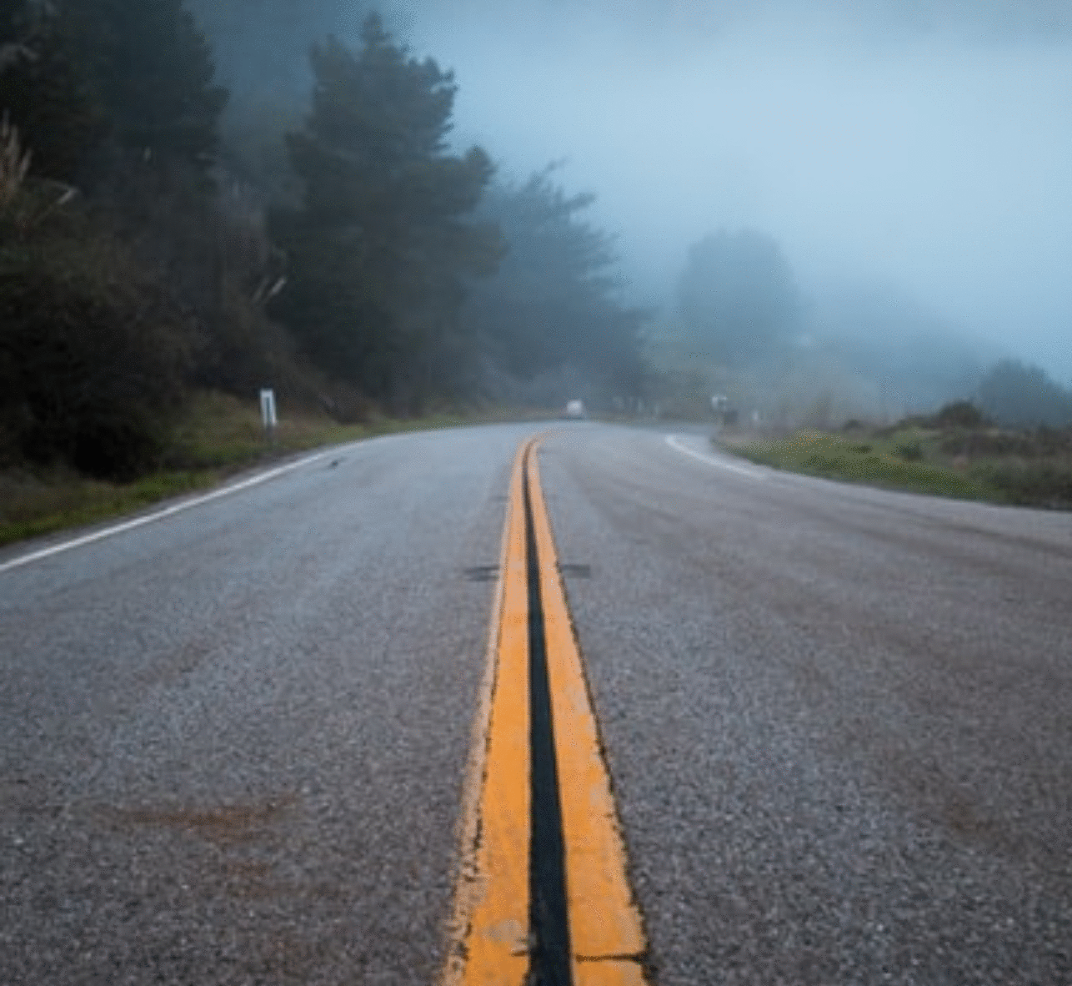
Road Lane Line Detection (RLLD)
Problem Statement:
Developing a robust lane line detection system for autonomous vehicles operating in foggy conditions using computer vision techniques (OpenCV).
Hook Line : Current lane line detection systems struggle in poor visibility, including fog, leading to safety concerns for autonomous vehicles.

Slide 5

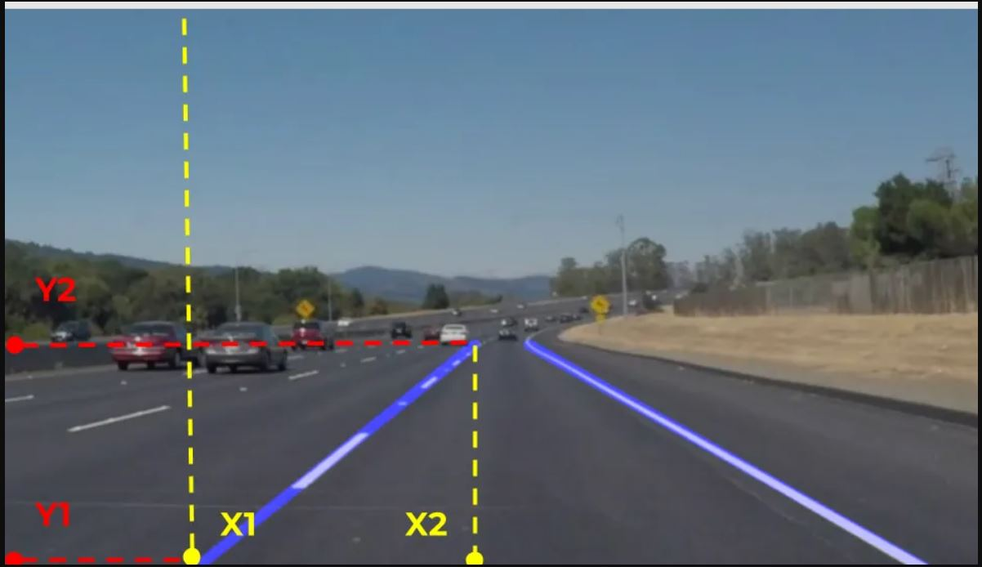


INTRODUCTION
The project seeks to use OpenCV to recognize lane lines in fog while also exploring the broad field of computer vision.
It will look at the effects of using computer vision and create a model that can accurately identify straight and curved lane lines in fog.
Artificial intelligence (AI) is being used more and more, and many areas of the technology are demonstrating significant promise for extending its capabilities.

Slide 6


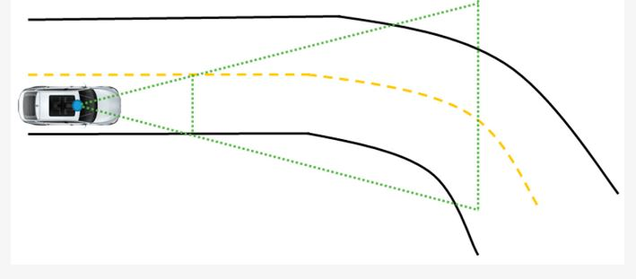

AIMS:
Understand the wide scope of Computer Vision
Implementing OpenCV to detect lane lines
Identifying the implications in implementing Computer Vision
Detecting straight and curve lane lines in fog
Attaining high accuracy for the designed lane line detection model

Slide 7
Scope of Computer Vision
Computer vision is a branch of artificial intelligence that allows machines to process and understand visual data.
Applications of computer vision include automated AI vision inspection, remote monitoring, automation, face recognition, self-driving cars and transportation.
The scope of computer vision involves developing algorithms and techniques for machines to interpret visual information from images or videos.
Tasks within computer vision include image recognition, object detection, tracking, image segmentation, 3D reconstruction, and more.

Slide 8
Similar Studies
⚪
⚪
⚪
⚪
Haque et al. (2019) developed a system for detecting lane lines on smooth road surfaces. Their approach relied on gradient and HLS thresholding techniques applied to binary images to identify the lane lines efficiently.
Truong et al. (2008) proposed a method to detect lane boundaries and estimate their curvature using monocular camera images. They used vector-lane-concept and NUBS interpolation to construct the lane boundaries and estimated their curvature for autonomous guided vehicle systems.
Assidiq et al. (2008) devised a real-time vision-based lane detection method resilient to lighting variations and shadows. By capturing the front view with a vehicle-mounted camera, lanes are detected using hyperbolas and Hough transform. This approach is effective on different road types and weather conditions, demonstrating robustness and speed for real-time applications.
Zhu (2021) employed image preprocessing techniques like perspective transformation, threshold processing, and mask operation, along with an optimized sliding window method, to accurately detect lane lines in high-resolution images.

Slide 9
METHODOLOGY:
The methodology opted for successful completion of this dissertation will include the following steps-
1. Data Collection: Gather video footage of different road scenarios.
2. Preprocessing: Apply image processing techniques to enhance lane markings.
3. Lane Detection: Develop algorithms to detect and track lane lines.
4. Evaluation: Assess the performance of the system using metrics such as accuracy and processing speed.

Slide 10
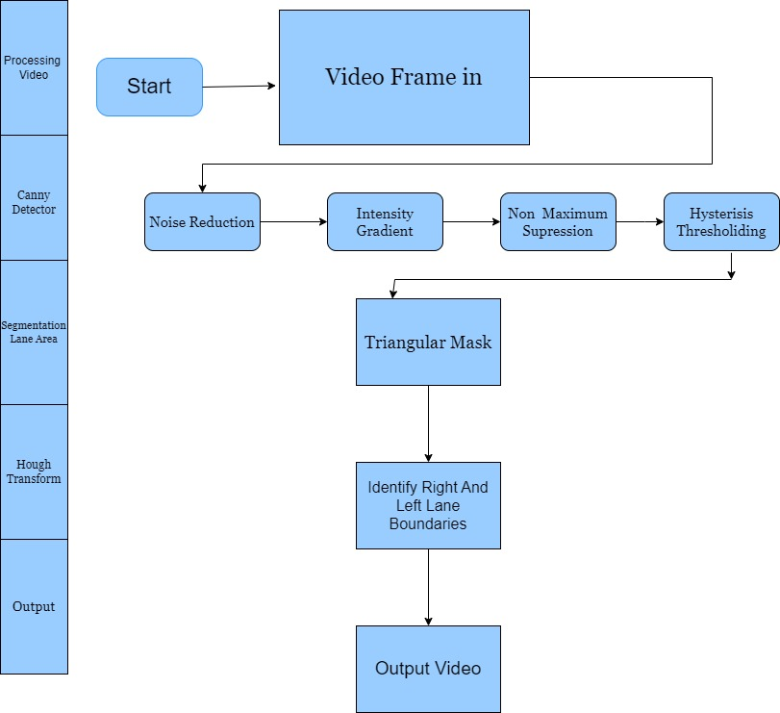

Slide 11
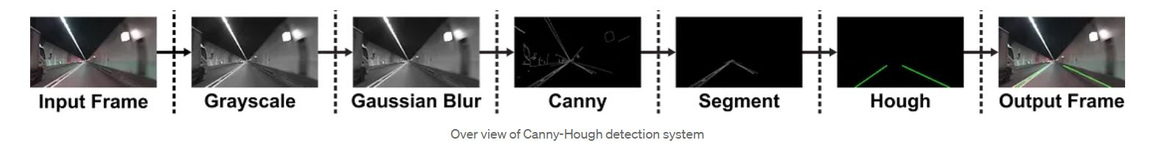
The following diagram is an overview of our pipe line:

Slide 12
Datasets for RLLD in Fog
Many datasets have been created in order to train and test road lane line identification techniques in fog.
The most popular datasets are the Foggy Lane Detection (FLD) dataset, which contains artificial fog photos created from the KITTI dataset, and the KAIST
Multi-spectral Day/Night Dataset, which contains RGB and thermal images taken in various weather situations, including fog (Sato and Chen, 2022).
In order to compare various road lane line identification techniques in foggy conditions, these datasets serve as a baseline.

Slide 13

Challenges
Lack of real-world fog datasets is one of the main issues, as it makes it difficult to build and test road lane line identification techniques in accurate environments.
Also, it is challenging to come up with a universal solution due to the variety of fog and weather circumstances.
The creation of reliable road lane line recognition techniques that can function in real-time and under various illumination circumstances continues to be a serious problem.

Slide 14
Future Direction
In future we can implement it using CNN(Convolutional Neural Networks.
So we will not be only dependent on the line detections using the Hough Transform, the model will became more precise and accurate.
Hence it will reduce the Causality as well as road accidents.

Slide 15
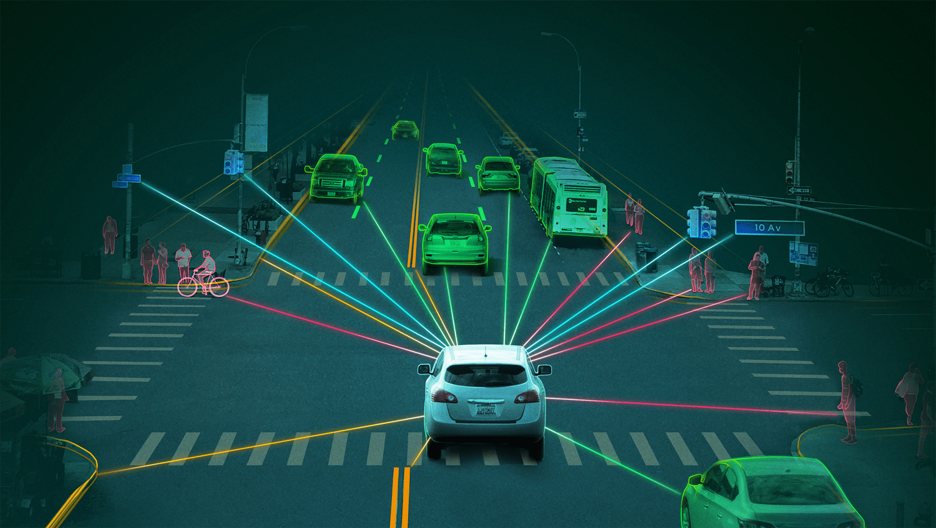
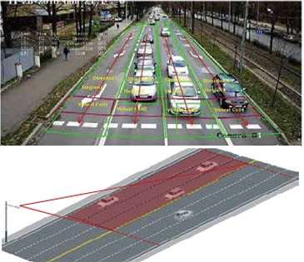

Use Cases
1.
2.
3.
Autonomous Vehicles
RLLD is crucial for self-driving cars to navigate safely on roads.
Traffic Management
The technology can be used in traffic management systems to monitor and analyze traffic flow patterns.
Pedestrian Safety
RLLD systems also contributes to pedestrian safety by detecting pedestrian crossings and designated walkways.

Slide 16

Conclusion
Road lane line detection is a critical component of autonomous driving systems.
Through this project, we have developed a robust algorithm for detecting lane markings, paving the way for safer and more reliable autonomous vehicles.

Slide 17
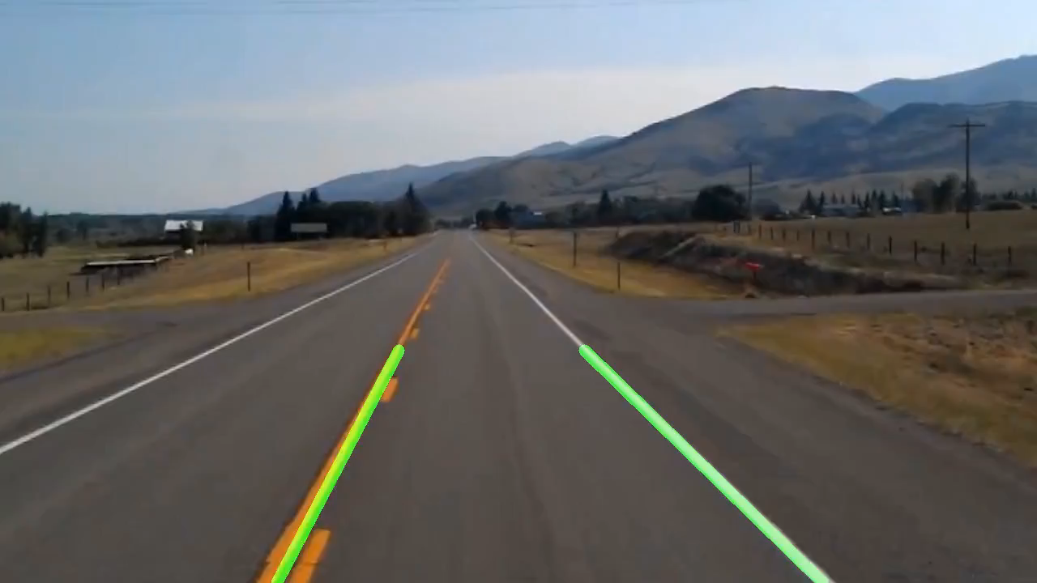
Visual Representation

Slide 18
References
Haque, M.R., Islam, M.M., Alam, K.S., Iqbal, H. and Shaik, M.E., 2019. A computer vision based lane detection approach. International Journal of Image, Graphics and Signal Processing, 10(3), p.27.
Truong, Q.B. and Lee, B.R., 2008, October. New lane detection algorithm for autonomous vehicles using computer vision. In 2008 International Conference on Control, Automation and Systems (pp. 1208-1213). IEEE.
Assidiq, A.A., Khalifa, O.O., Islam, M.R. and Khan, S., 2008, May. Real time lane detection for autonomous vehicles. In 2008 International Conference on Computer and Communication Engineering (pp. 82-88). IEEE.
Zhu, H.G., 2021, March. An efficient lane line detection method based on computer vision. In Journal of Physics: Conference Series (Vol. 1802, No. 3, p. 032006). IOP Publishing.

Slide 19

Thank You!
Thank you for your attention.
We welcome any questions or feedback you may have.

